Slide 1




YouTube Song Analysis
PowerBi Analysis
Batch No: MIP-DA-10
Kolapo Mayowa

Slide 2



Report Outline
History Of YouTube Song
Introduction to the Dataset
Dataset Overview
Dataset Problem Objectives
Problem Objectives
Data Exploration using PowerBI
Insights and Recommendations

Slide 3

HISTORY OF YOUTUBE SONGS
YouTube Overview:
YouTube, founded by Chad Hurley, Steve Chen, and Jawed Karim in February 2005, is a video-sharing platform that has revolutionized the way people consume video content. Originally started as a platform to upload, share, and view videos, It has grown into a global phenomenon that hosts billions of videos ranging from entertainment, education, news, and more.
YouTube Songs:
The evolution of YouTube as a hub for music content has been remarkable. From independent artists to major record labels, YouTube has become an essential platform for music discovery and distribution.
Milestones in YouTube Songs:
Key milestones in YouTube songs include the introduction of Vevo in 2009, the rise of YouTube-born musicians in 2010, the launch of YouTube Music Awards in 2013, the introduction of YouTube Red (now YouTube Premium) in 2015, the launch of YouTube Music in 2018 dedicated music streaming services, competing with Spotify and Apple Music
T-Series becomes the most subscribed YouTube channel globally, exemplifying YouTube’s significance in the music industry,

Slide 4


Introduction to the Dataset
Data Cleaning Process:
This internship project aims to conduct a comprehensive analysis of YouTube songs data using Power BI. The dataset contains key attributes such as video ID, channel title, title, description, tags, published date, view count, like count, favorite count, comment count, video duration, video definition, and caption details. The goal is to utilize Power BI to create insightful visualizations and reports that provide a deeper understanding of YouTube songs' performance, popularity, and user engagement. The analysis aims to uncover trends, preferences, and patterns in the data to aid content creators and stakeholders in optimizing their YouTube song content.
Reviewed the data types for each column to ensure they were properly assigned (e.g., numeric columns as integers, date/time columns in the right format).
Identified columns with missing or null values and decided on appropriate mitigation strategy. E.g., Column Description has blank rows, which I replaced with Not Specified.
Scanned the datasets for any duplicate records that could skew the analysis.
Observed that the original title columns contained lengthy, unwieldy text that would be difficult to work with in the visualization. I created a new column called “Song Title” that extracted the core song title from the original title column.
Derived new columns like Day name, Quarter, Month name, Year from Publishedat column.
Derived new column named Duration Category from the Duration Column. which I break it into High, Medium ,Low.

Slide 5
Dataset Overview
This project provides interns with hands-on experience in leveraging Power BI for meaningful analysis in the dynamic domain of YouTube songs, contributing insights to optimize content strategy and engagement.
The dataset consists of 13 columns and 19,345 rows.
The dataset description is shown below:
1. video_id: Unique identifier for each YouTube video.
2. channelTitle: Title of the YouTube channel publishing the song.
3. title: Title of the YouTube song video.
4. description: Description provided for the YouTube song video.
5. tags: Tags associated with the YouTube song video.
6. publishedAt: Date and time when the YouTube song video was published.
7. viewCount: Number of views received by the YouTube song video.
8. likeCount: Number of likes received by the YouTube song video.
9. favoriteCount: Number of times the YouTube song video has been marked as a favorite.
10. commentCount: Number of comments posted on the YouTube song video.
11. duration: Duration of the YouTube song video.
12. definition: Video definition or quality (e.g., HD, SD).
13. caption: Availability of captions for the YouTube song video

Slide 6



Problem Objectives
To uncover the key factors that drive higher user engagement with YouTube music video content, as measured by metrics such as likes, comments.
1. Exploratory Data Analysis (EDA):
- Explore patterns and distributions in view counts, like counts, and comments.
- Identify trends in the popularity and engagement of YouTube song videos.
2. Content and Channel Analysis:
- Analyze the distribution of videos across different channels.
- Identify popular tags and their correlation with view counts.
3. Temporal Trends:
-Explore how YouTube song video metrics vary over time.
- Identify peak publishing times and their impact on engagement.
4. User Engagement Insights:
- Investigate relationships between likes, comments, and views.
- Identify factors influencing user engagement with YouTube song videos.

Slide 7

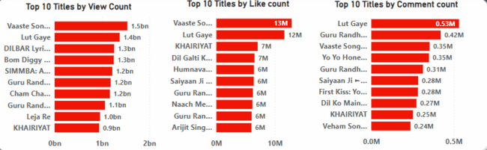
Exploratory Data Analysis (EDA)
Patterns and Distributions in View Counts, Like Counts, and Comments
Dataset Overview: The dataset contains 19.14 thousand songs with a total of 216 billion views, 45 million comments, and 2 billion likes.
Top Songs by Metrics:
Highest View Count: "Vaaste" (1.54 billion), "Lut Gaye" (1.37 billion), followed by "Dibar Lyrical"
Highest Like Count: "Vaaste" (12.8 million), "Lut Gaye" (11.6 million), "Khairiat" (7.1 million)
Highest Comment Count: "Lut Gaye" (0.53 million), "Guru Randhawa Song" (0.42 million), "Vaaste" (0.35 million)

Slide 8
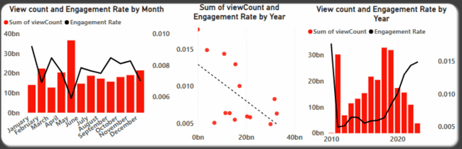
Exploratory Data Analysis
Trends in Popularity and Engagement of YouTube Song Videos
Monthly Trends:
Highest View Count: May, followed by February and April; March has the lowest view count.
Engagement Trends: Higher monthly view counts often correlate with lower engagement rates. For instance, January's view count increase was accompanied by a drop in engagement rate from 0.92% to 0.69%.
Exceptions: October to November showed simultaneous increases in both view count and engagement rate, from 0.81% to 0.83%.
Yearly Trends:
Highest View Count: 2018, followed by 2019 and 2011; 2010 has the lowest view count.
Engagement Trends: In 2010, despite having the least number of views, the engagement rate was the highest at 1.76%. In contrast, 2011 saw a significant increase in views, but the engagement rate dropped sharply to 0.49%. Similarly, in 2023, although the views were low, the engagement rate was relatively high at 1.49%, closely following 2010. This trend indicates that as the view count decreases, the engagement rate tends to increase, suggesting that a smaller audience is more likely to interact with the content.

Slide 9
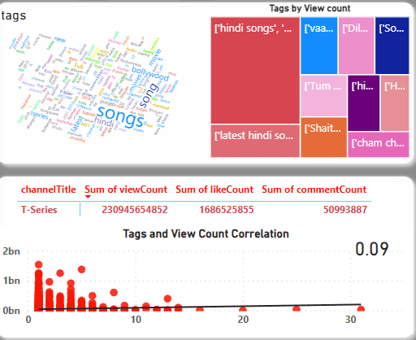
Content and Channel Analysis
Distribution of Videos Across Different Channels
T-Series Channel:
Total songs published: 19.35k
Total views: 231 billion
Total comments: 51 million
Total likes: 2 billion
Popular Tags and Their Correlation with View Counts
Popular Tags: "Songs," "song," "latest," "Bollywood," "movie," "new," "movies," "Hindi," "T-Series," "full," "trailer," "2" (each appearing over 1,000 times).
Tag-View Correlation: Very weak correlation (0.09), suggesting tags do not significantly influence view counts.
Your paragraph text

Slide 10
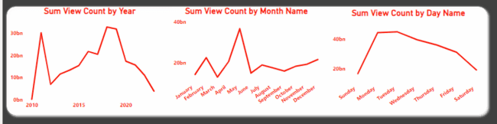
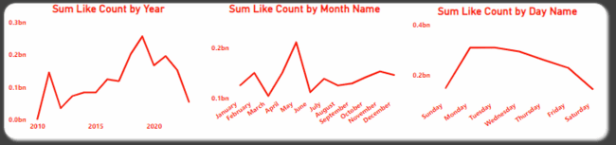
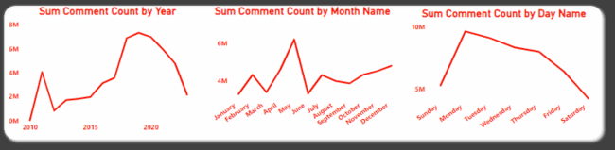
Temporal Trends:
Explore how YouTube song video metrics vary over time
Yearly Trends
In terms of view counts, 2010 had the least view count, followed by 2023. The highest view counts were observed in 2018, 2019, and 2011. For like counts, 2010 had the least, followed by 2012 and 2024, while 2019 had the highest like count, followed by 2018. In terms of comment counts, 2010 had the lowest, while 2019 had the highest, followed by 2020 and 2018.
Monthly Trends
May had the highest view count, followed by February, December, and April, with March having the least view count. May also had the highest like count, followed by November and February. The highest comment count was in May, with January having the least.
Daily Trends
Songs published on Tuesday had the highest views, followed by Monday and Wednesday, while Sunday and Saturday had the least. Like counts followed a similar pattern, with Tuesday having the highest and Sunday and Saturday having the least. For comment counts, Monday had the highest, while Saturday and Sunday had the least.

Slide 11
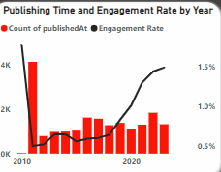
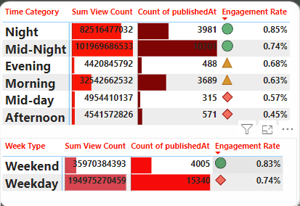
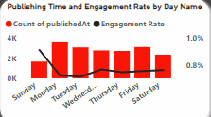
Peak Publishing Times and Their Impact on Engagement
In 2010, despite having the fewest published songs, the engagement rate was the highest at 1.76%, suggesting that fewer videos can lead to higher user engagement. In contrast, 2011 had the most songs published but the lowest engagement rate at 0.49%, indicating that a larger volume of content might dilute user engagement.
May had the highest number of published songs but recorded the lowest engagement rate of 0.59%, likely due to the spread of user interactions across many videos. On a weekly basis, Sunday had the highest engagement rate despite not being the peak publishing day. The peak publishing day was Monday, which had lower engagement compared to Sunday, possibly because users have more free time to engage with videos on weekends.
YouTube songs published at midnight have the highest view count and the most frequent publishing time, with an engagement rate of 0.74%. Nighttime publications follow, with the second-highest views and the highest engagement rate of 0.85%. Afternoon releases have the lowest engagement rate, possibly due to lower user activity during this time.

Slide 12
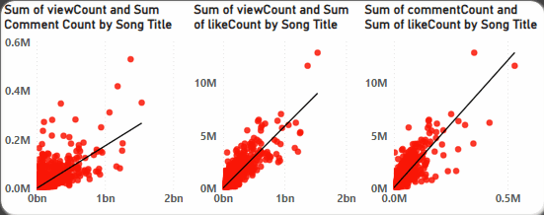
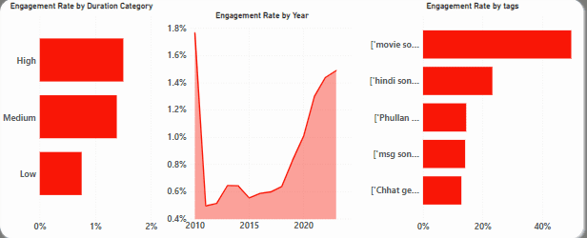
User Engagement Insights
Investigate relationships between likes, comments, and views.
Comment Count and Like Count: Strong positive correlation (0.88).
Comment Count and View Count: Strong positive correlation (0.85).
Like Count and View Count: Near-perfect positive correlation (0.96).
Conclusion: Higher view counts drive higher likes and comments, indicating that popular videos generate more user interactions.
Identify factors influencing user engagement with YouTube song videos.
Video Duration:
Short Duration: Highest view counts, comments, and likes, but lowest engagement rate (0.75%).
Long Duration: Least view counts, comments, and likes, but highest engagement rate (1.50%).
Conclusion: Shorter videos attract more interactions, but longer videos engage viewers more deeply.
Year of Publication:
2010: Highest engagement rate (1.76%).
2023: Second highest engagement rate (1.49%).
Conclusion: The time period in which content is released affects viewer interaction.
Tag Usage: Popular tags like "song" are associated with high engagement rates.

Slide 13
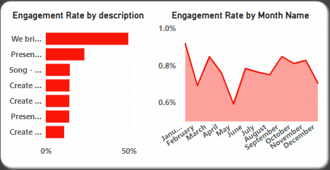
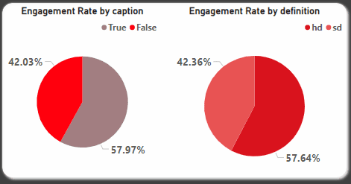
User Engagement Insights
Identify factors influencing user engagement with YouTube song videos.
Descriptions like “We bring to you the video song of the upcoming song” have exceptionally high engagement rates (49.69%).
Conclusion: Specific promotional phrases can significantly boost engagement.
May recorded the lowest engagement rate at 0.59%.
January having the highest engagement rate suggests that the month is a factor influencing user engagement.
Conclusion: This pattern indicates that user activity and interaction levels can vary significantly depending on the time of year, making the month a relevant factor in understanding and optimizing engagement rates for YouTube song videos.
Video Quality:
HD Videos: 57.64% engagement rate.
SD Videos: 42.36% engagement rate.
Conclusion: Higher-quality videos attract more engagement.
Caption Availability:
Videos with Captions: 57.97% engagement rate.
Videos without Captions: 43.03% engagement rate.
Conclusion: Providing captions significantly improves viewer engagement, likely by making content more accessible.

Slide 14


Insights
Exploratory Data Analysis (EDA)
High Engagement Year: 2010 had the highest engagement rate at 1.76%.
Low Engagement Year: 2011 had the highest views but the lowest engagement rate at 0.49%.
Monthly Trends: May had the highest views and comments but the lowest engagement rate at 0.59%.
Daily Trends: Sunday had the highest engagement rate at 0.91%, while Tuesday had the highest views.
Content and Channel Analysis
Channel Performance: T-Series published 19.35k songs with 231 billion views, 51 million comments, and 2 billion likes.
Popular Tags: Common tags include “Songs,” “Song,” “Latest,” etc., with a weak correlation to view counts (0.09).
Descriptive Impact: Descriptions like “We bring to you the video song of the upcoming song” have high engagement rates.
Quality and Captions: HD videos and those with captions have higher engagement rates.
Temporal Trends
Yearly Peaks: Engagement rates are higher when fewer videos are published, as seen in 2010.
Monthly Peaks: Higher engagement during lower publishing months.
Daily Peaks: Highest engagement on Sundays despite being the least published day.
Time of Day: Nighttime videos have the highest engagement rate at 0.85%.
User Engagement Insights
Interaction Correlation: Likes, comments, and views have strong positive correlations.
Video Duration: Longer videos have higher engagement rates (1.50%) despite lower view counts.
Quality and Captions: HD and captioned videos significantly improve engagement.
Descriptive Impact: Specific engaging descriptions boost interaction rates.

Slide 15

Recommendations
Exploratory Data Analysis (EDA)
Publish in High Engagement Periods: Focus on periods like January and Sunday for higher engagement.
Promote Successful Content: Create more content similar to high-performing songs.
Enhance User Interaction: Use calls to action to increase likes and comments.
Content and Channel Analysis
Strategic Use of Tags: Use popular tags while focusing on content quality.
Engaging Descriptions: Use promotional and catchy descriptions to attract viewers.
Diversify Content: Innovate to maintain audience interest and engagement.
Temporal Trends
Optimize Publishing Times: Schedule releases for nighttime and weekends for higher engagement.
Balance Content Volume: Avoid oversaturating any period to maintain consistent engagement.
Capitalize on Engagement Days: Focus on Sundays for significant content releases.
User Engagement Insights
Encourage Interaction: Use strategies to prompt likes and comments.
Invest in Longer Content: Create high-quality, longer-duration videos.
Use HD and Captions: Ensure videos are high-definition and captioned.
Adapt to Trends: Monitor and adapt to changing user engagement trends.

Slide 16
Thank you !

